Slide 1
BUILDING OF A NEW
MULTI PURPOSE
RESEARCH VESSEL
Hellenic Centre
for Marine Research
45 MEuros
EUROPEAN RESEARCH VESSEL OPERATORS
Hamburg 12 June 2019

Slide 2
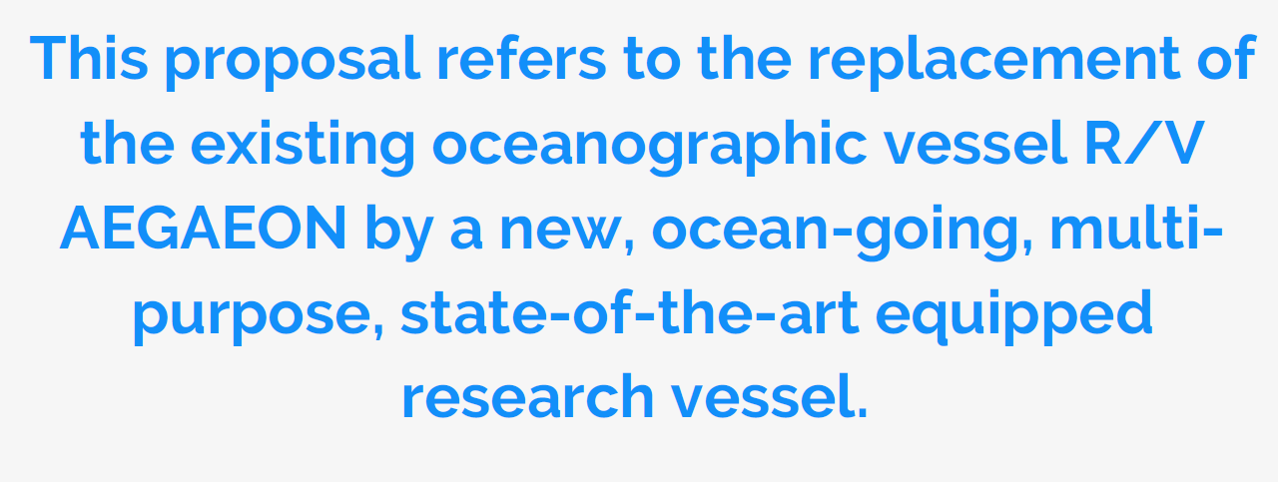

Slide 4
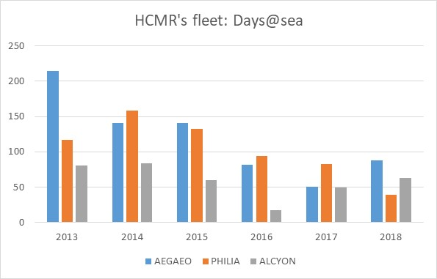

Slide 5
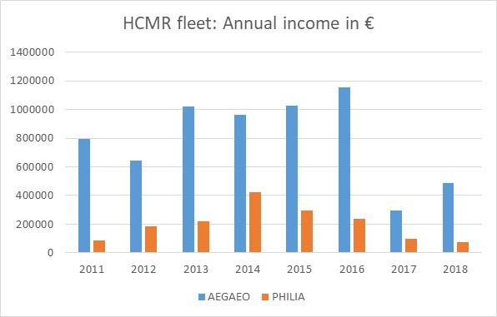

Slide 6
What were the criteria used to select or prioritise the type of research the new vessel will be able to perform (e.g. choice of laboratories and equipment, etc.)?
Scientific criteria:
Priorities set by the national research strategy of Greece and research priorities defined by the European Commission:
the study of and response to climate change,
the Blue Growth strategy,
the ocean / blue energy,
the sustainable exploitation of the seabed.
The major, thematic, research axes prioritized by HCMR are the following:
ocean observatories and forecasting systems,
marine ecosystems research, marine ecosystem health and environmental status,
coastal processes, integrated coastal zone management and
earth’s crust long-term dynamics and kinematics and geohazards.

Slide 7
Priorities and research axes cover a wide range of research objectives to be implemented through the use of the new vessel include:
High-resolution seafloor survey with the use of advanced acoustic techniques for geomorphological mapping, nature of the seafloor and mapping of seabed habitats as well as for the documentation of submerged cultural heritage.
Shallow and deep geophysical, 2D and 3D seismic and seismological surveys for the study of the seafloor, the geological and tectonic structure below the seafloor and at deeper levels of the Earth’s crust and the understanding of active geological and tectonic processes and geohazards (active faults, earthquakes, seismic hazard, landslides, etc.)
Water and environmental sampling, sediment sampling/coring and on board processing of the samples and cores in adequately equipped laboratories for research on climate change, understanding ocean circulation, mapping biodiversity etc.
Oceanographic measurements and deployment/handling of oceanographic buoys for ocean observation and climate monitoring (e.g. POSEIDON, COPERNICUS)

Slide 8
Monitoring fish population dynamics in order to a) provide advice on the sustainability of fish resources, b) predict climate change effects on fish population dynamics and c) explore new resources especially in terms of mesopelagic and deep sea fish populations.
Fish population and environmental sampling to model and map changes in essential fish habitat under climate change scenarios.
Fish and invertebrates sampling to monitor and model the effect of lessepsian fish species and invertebrates under climate change scenarios.
Deployment and operation of ROVs, AUVs
Maintenance of deep seafloor observatories, e.g. EMSO HELLAS observatory
Search and recovery operations in cases of maritime or aircraft accidents
Research activities and operations related with major European research policies e.g. Marine Spatial Planning, Blue Growth, Marine Strategy Framework Directive, Water Framework Directive

Slide 9
B) Operational criteria:
The type of research the new vessel will perform, requires oceanographic cruises in the open sea and research activities at full ocean depth.
The new vessel is expected to be able to operate at open sea conditions in the Mediterranean, Black and Red Seas and probably beyond those, in the Indian Ocean and parts of the Atlantic Ocean
The new ship is not intended for Arctic operation.

Slide 10
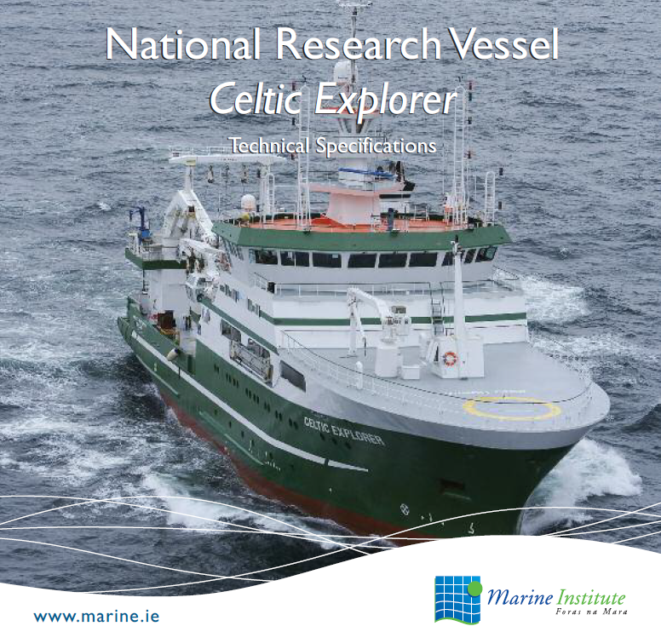
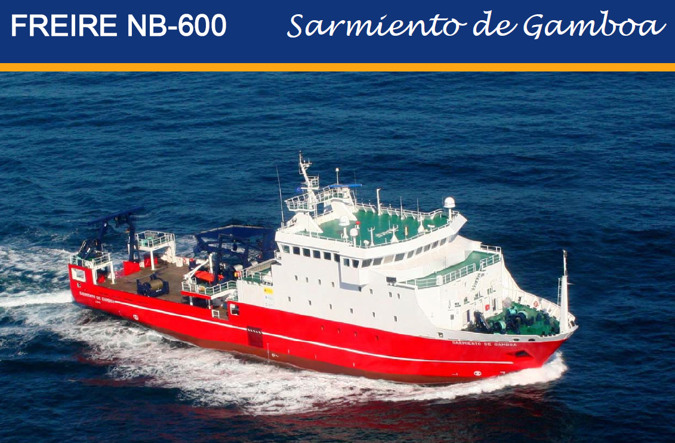
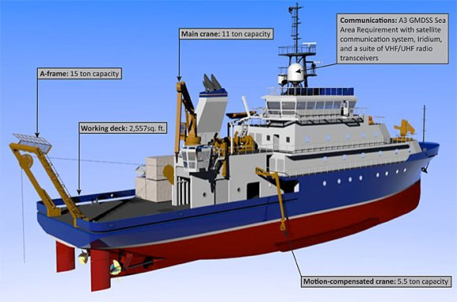
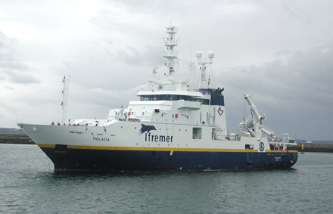
R/V Neil Armstrong
R/V Thalassa

Slide 11
Main characteristics of the new vessel
Main Particulars |  | Min | Max | AEGAEO
Length Over All | [m] | 68.0 | 72.0 | 61.51
Beam | [m] | 15.0 | 15.6 | 9.6
Scantling Draught | [m] |  | 5.7 | 2.9
Depth to Bulkheads Deck | [m] | 6.5 |  | 4.2
GRT | - |  | 3500
DWT | [t] | 900.0 |  | 155
Fuel Oil | [m³] | 400.0 |  | 106.6
Fresh Water | [m³] | 150.0 |  | 75
Fresh Water making capacity | [m³/day] | 10.0
Speed Cruising | [kn] | 10.5
Speed Max. | [kn] | 12.0
Propulsion Type | - | Diesel Electric, Azimuth Pod Propulsion
Propulsion Power | [kW] |  | 2400.0 | 1396.5
Main Generators (3 or 4 GenSets) | [kW] | 4000.0 |  | 600
Range at Cruising Speed | [nm] | 8500.0
Endurance | days | 50

Slide 12
Main characteristics of the new vessel
Main Particulars |  | Min | Max | AEGAEO
Stabilization | - | Anti-rolling tanks
Dynamic Positioning | - | DP2 |  | -
Bow Thrusters | [kW} | 2x300.0
Main Crane | [tm] | 60.0 |  | 30
Second Crane | [tm] | 30.0 |  | -
Aft A-Frame | [t] | 15.0 |  | 10
Side A-Frame | [t] | 15.0
Articulated Side A-frame for Bathysounder Hydrology or Equivalent | [t] | 5.0
Free Deck Area at Main Deck (aft) | [m²] | 300.0 |  | 75

Slide 13
Main characteristics of the new vessel
Main Particulars |  | Min | Max | AEGAEO
Chemical & Biological Lab | [m²] | 45.0 |  | 30
CTD Control Room | [m²] | 10.0 |  | 6
Geophysical Lab | [m²] | 50.0 |  | 35
Wet Lab | [m²] | 20.0 |  | 12
Computer Lab | [m²] | 20.0 |  | -
Meeting room | [m²] | 30.0 |  | 16
Total Lab Area | [m²] | 175.0 |  | 99
20ft Container Capacity (Labs, Equipment or Storage) | - | 4 |  | 1
Preservation/Cooling Room | [m2] | 2x10.0 |  | -
Electrical workshop | [m2] | 15.0 |  | -
Mechanical workshop | [m2] | 15.0 |  | -
Transducers room at tank top | [m2] | 50.0 |  | -
Accommodation (total) | - | 50 |  | 41
Class | - | IACS
Flag | - | Greek |  | Greek
Owner | - | HCMR |  | HCMR

Slide 14
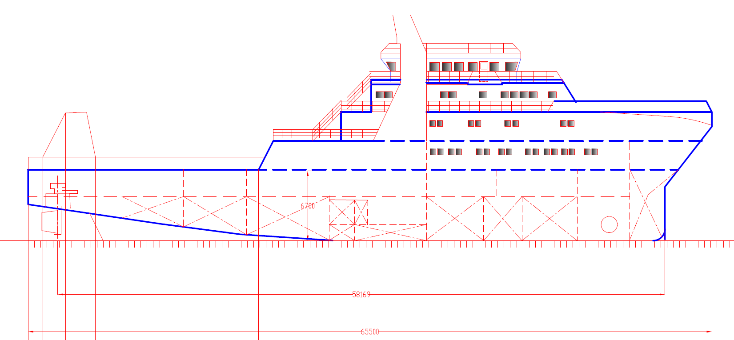
Table 12. Main characteristics of the new vessel
Deck 5
Deck 4
Deck 3
Deck 2
Deck 1

Slide 15
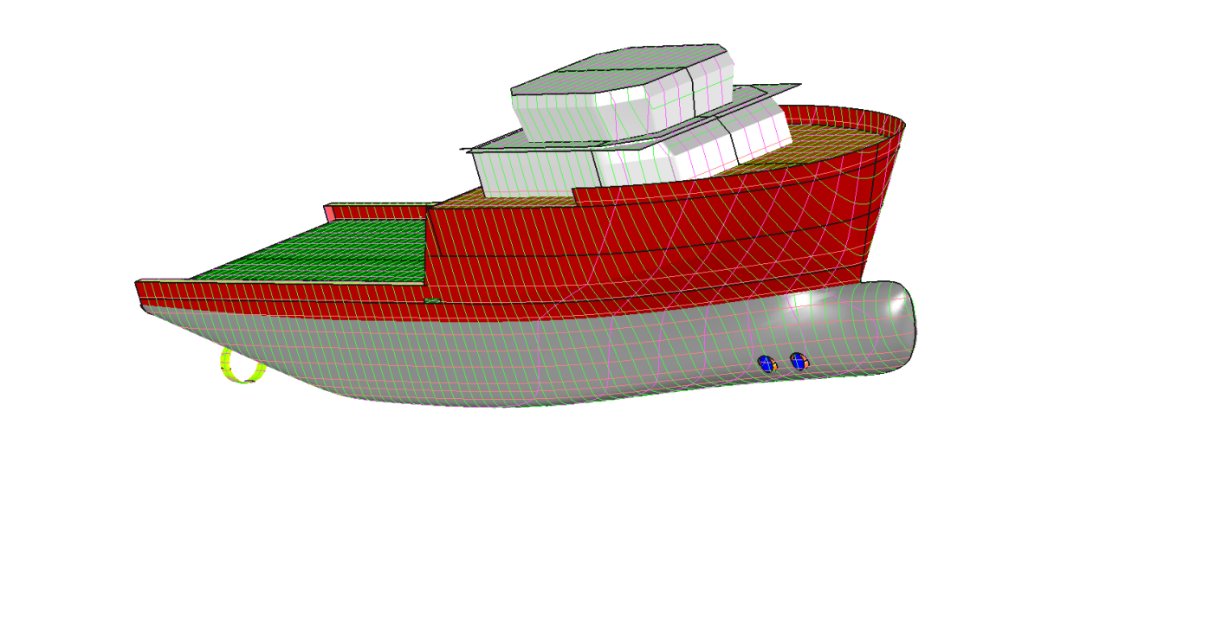
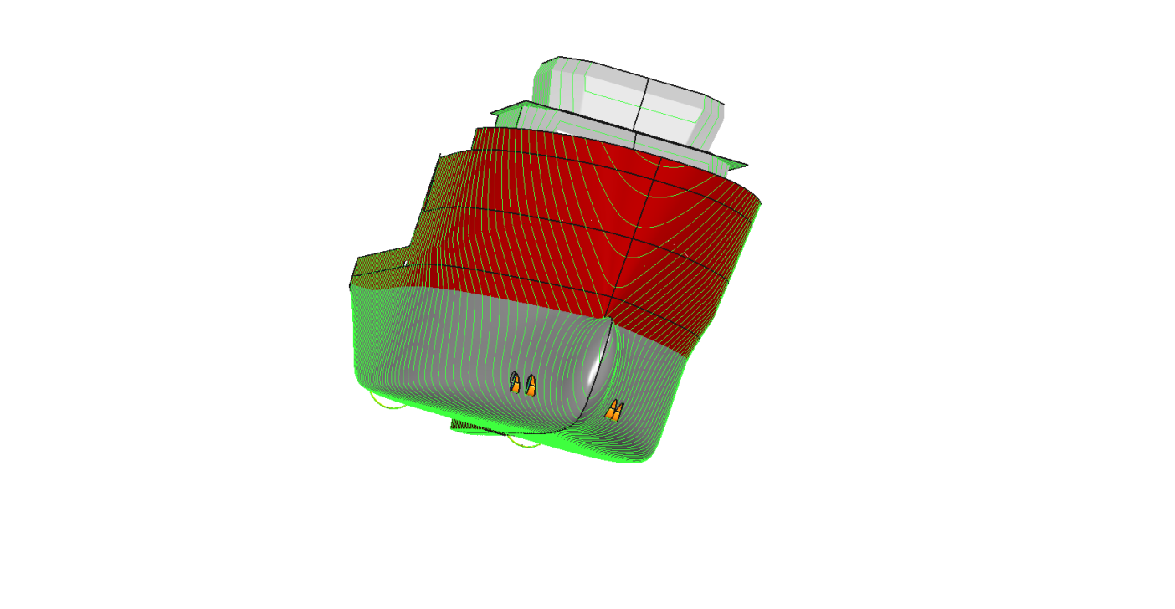
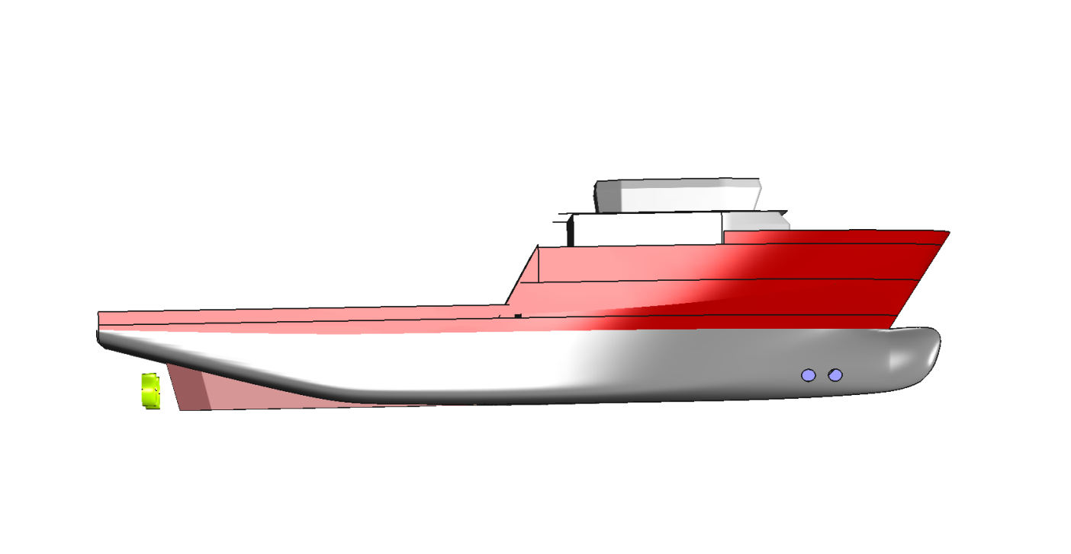
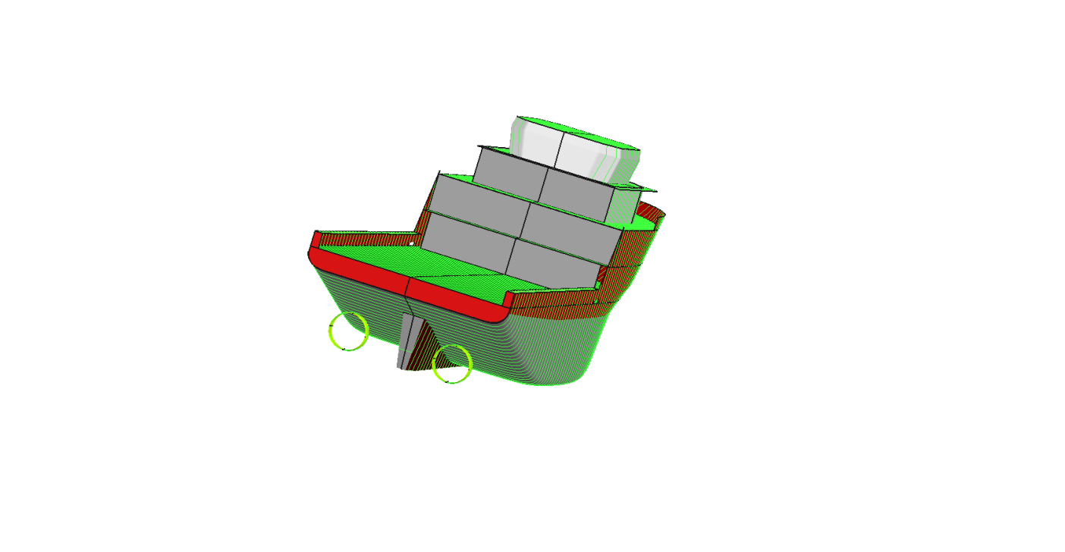

Slide 16
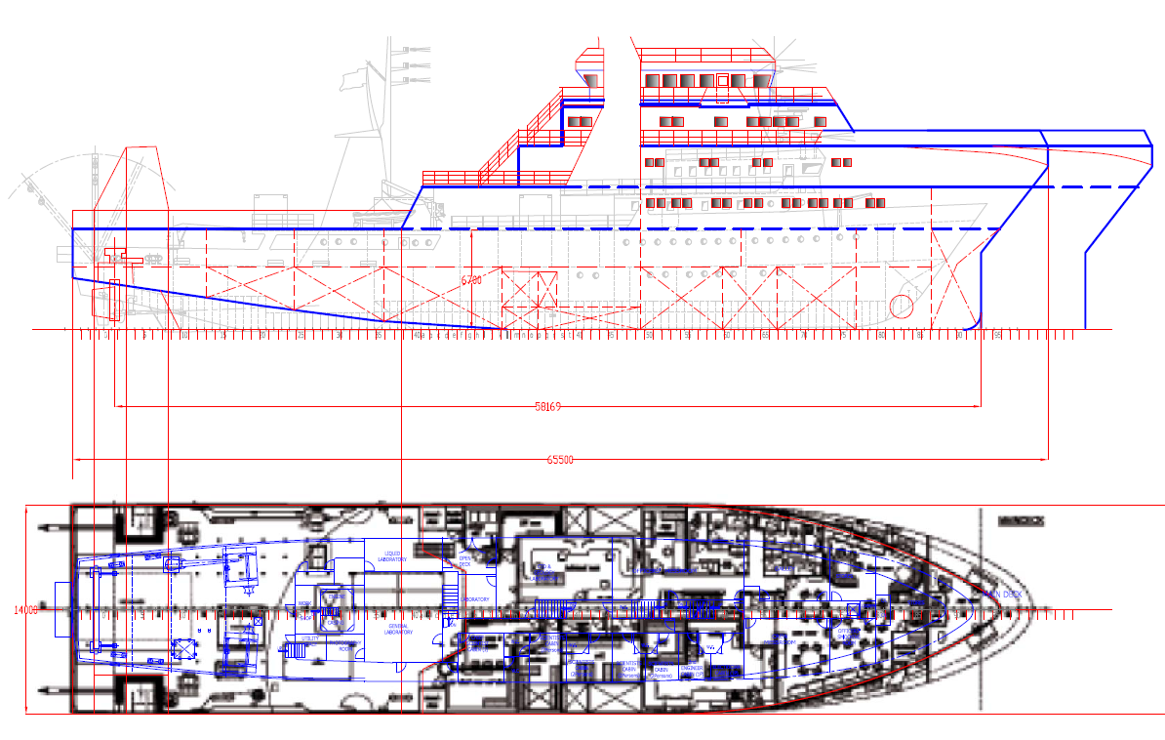

Slide 17
Scientific / Research Equipment – 10-15 M€
1 | ROV, 4500m rated
2 | Deep water Multi beam 5000m, hull mounted
3 | Shallow water Multi beam system (<500 m), hull-mounted
4 | Multi-Channel Seismic Reflection System
5 | Sub-bottom profiler, hull-mounted
6 | Corer 15m long, Winch / wire rope 6000 m long
7 | CPT in-situ geotechnical measurements
8 | ADCP hull mounted
9 | CTD, rosette, 24 bottles, winch / tow cable 6000 m
10 | Chemical, biological and & wet Laboratories equipment: fume hoods, clean bench, Milli-Q, centrifuge, spectrometer, chromatograph, nutrients analyzer etc.
11 | Deep tow DSS positioning system
12 | Multi-net
13 | Two winches, 12 tones capacity each

Slide 18
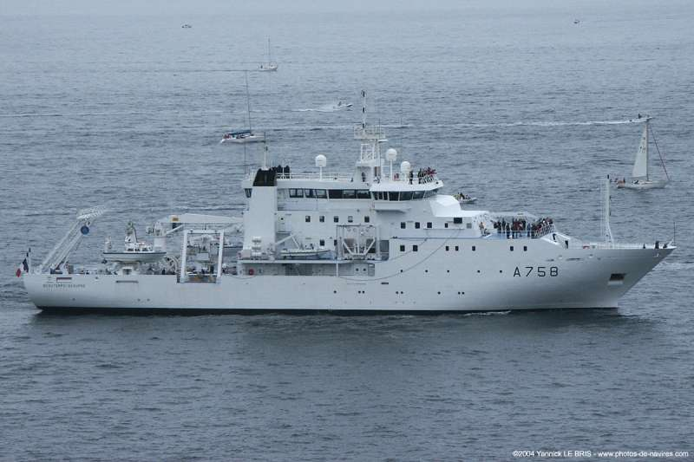
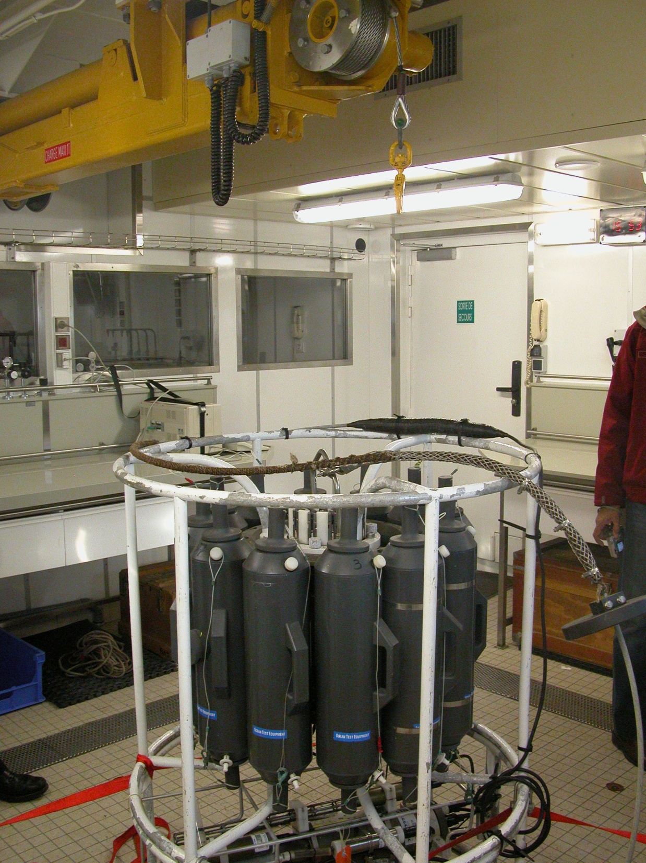
CTD / Rosette Deployment
Beautemps-Beaupre

Slide 19
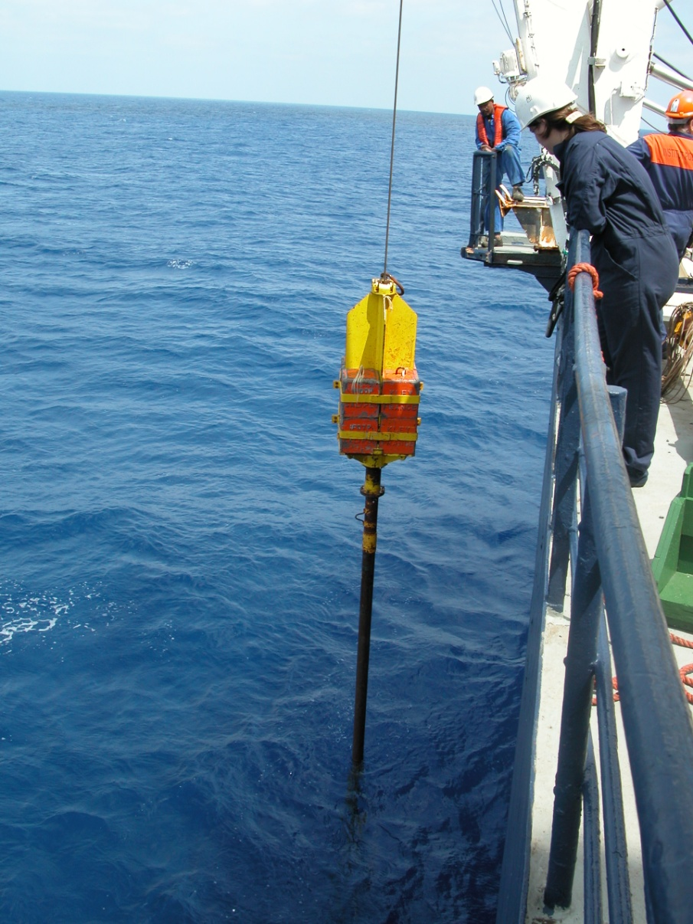
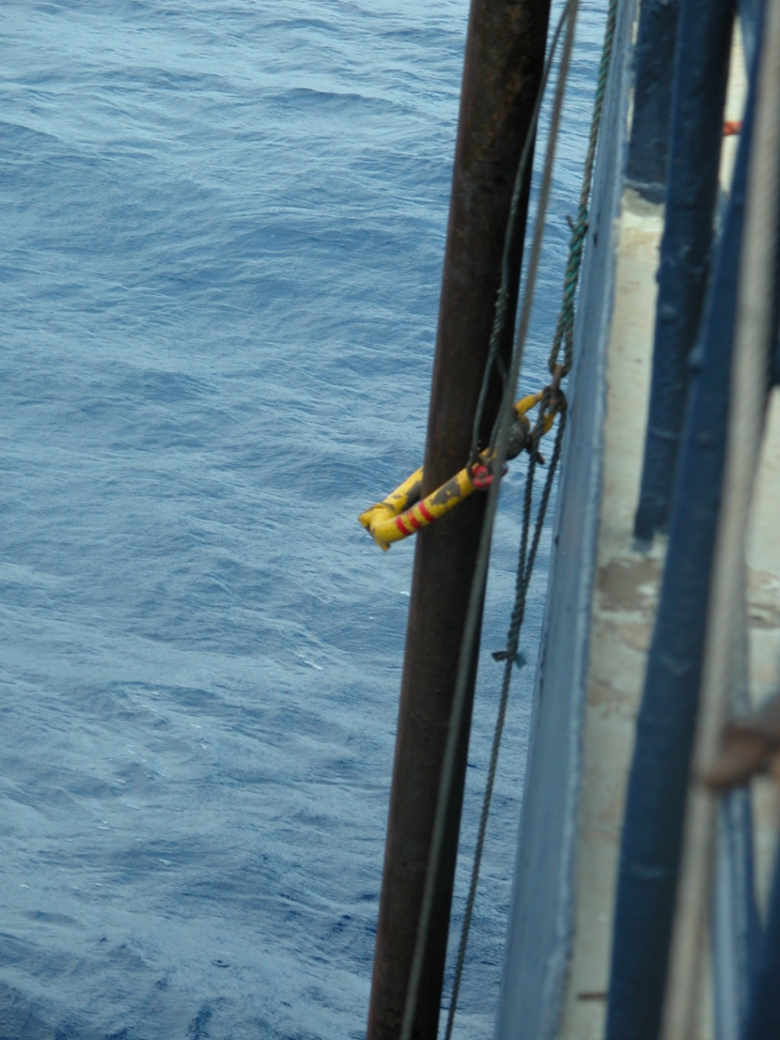
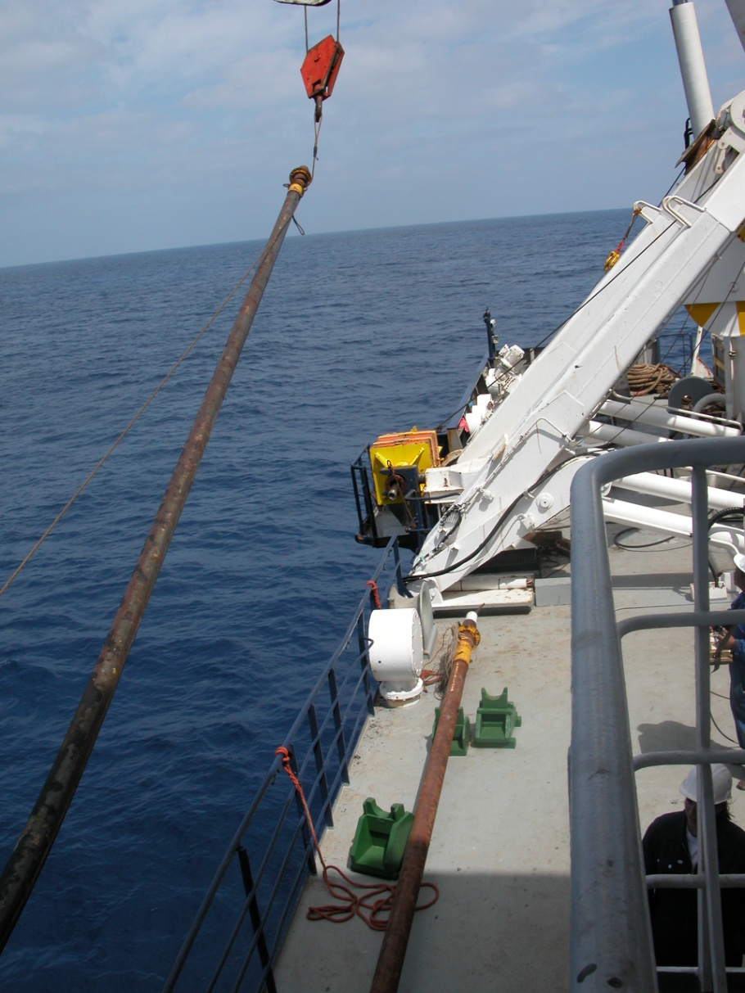
Coring from a side-frame

Slide 20
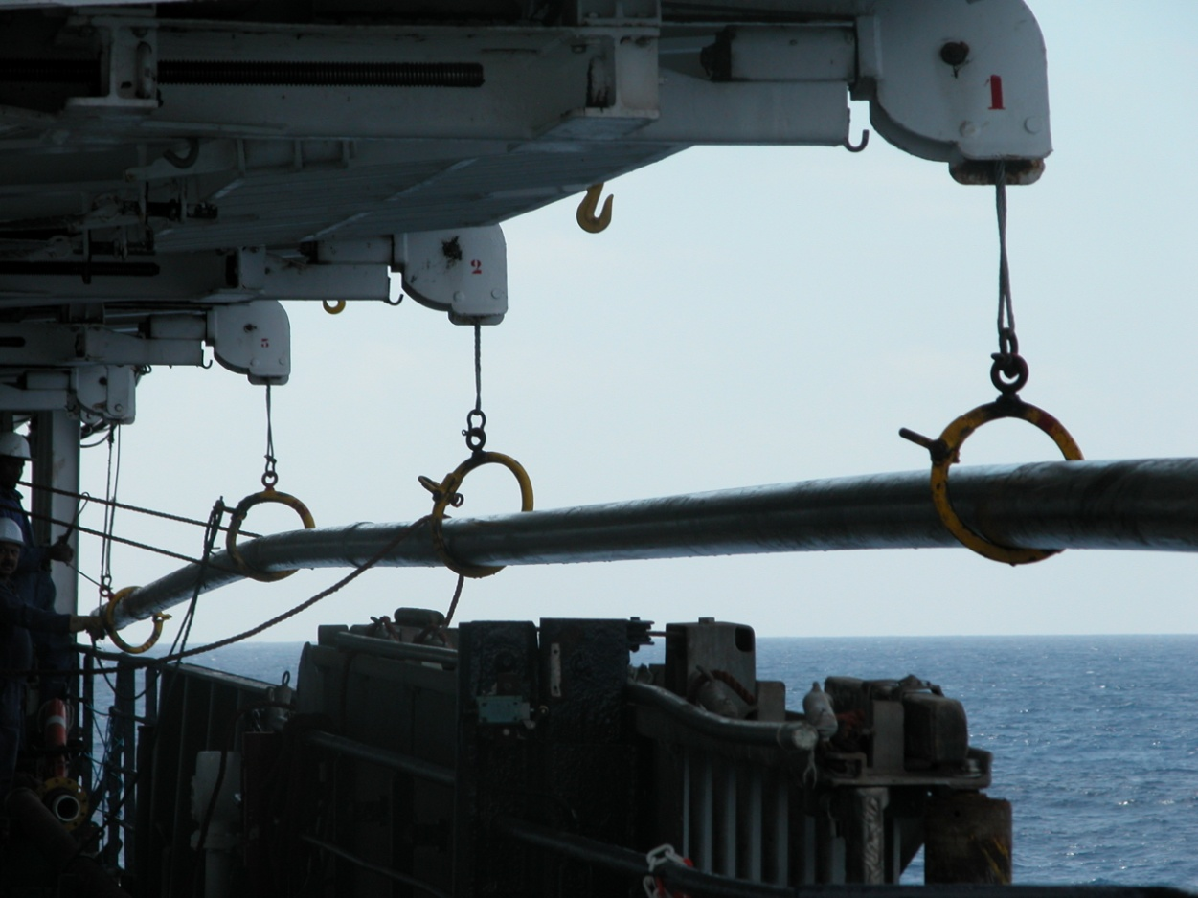
Coring from a side-frame

Slide 21
Investment Costs
 |  | PROJECT NAME: New Research Ship | CONSTRUCTION PERIOD |  | COST
 |  |  | START | END | M€ | %
1 |  | Initial Design | M1 | M26 | 1,5 | 3.3%
 | 1.1 | Basic Research - Concept Design
 | 1.2 | Preliminary Design
 | 1.3 | Contract design
 | 1.4 | Technical Specification
 | 1.5 | Call for tenders (Including Preparation, Elaboration, Evaluation)
2 |  | Contract signature | M26 | M30
3 |  | Ship's construction | M30 | M60 | 38 | 83.5%
 | 3.1 | Structures
 | 3.3 | Propulsion
 | 3.3 | Electrical
 | 3.4 | Electronics & Navigation
 | 3.5 | Auxiliary Systems
 | 3.6 | Outfit & Furnishings
 | 3.7 | Research Equipment
 | 3.8 | Test & Trials
 | 3.9 | Ship's Delivery
 | 3.10 | Training of the crew / ship's Technicians
4 |  | Portable Research Equipment | M58 | M60 | 5 | 11.0%
 | 4.1 | ROV + umbilical winch
 | 4.2 | Portable container workshops
5 |  | Owners costs | M30 | M60 | 1 | 2.2%
 |  | TOTAL |  |  | 45500 | 100.0%

Slide 22
Indicative Timeline
1. Basic Design / Finalization of operational requirements | M1 to M6
2. Contract Design | M7 to M15
3. Technical Specification | M14 to M16
4. Call for tenders (Including Preparation, Elaboration, Evaluation) | M16 to M26
5. Contract Signature | M26 to M30
6. Detailed design / Shop Drawings | M30 to M36
7. Ship Construction and Outfitting | M36 to M56
8. Commissioning - Sea Trials | M56 to M58
9. Training | M58 to M60

